Slide 1
NODA
NODA Group Management Policy Presentation

Slide 2
1, Representative Director Yuki Noda.
Ceramic Technology Research

Slide 3
Preliminary results.
Sales: 57.83 million (87%) (last year 50.80 million).
1, Charge achievement rate 96% (last year 86%).
Unable to reach the goal, the amount of work.
Ensuring was the biggest challenge.
1, Sales have been sluggish since May.
Charge has also worsened.
In January, in terms of attendance and work.
There was a problem and I provided guidance.

Slide 4
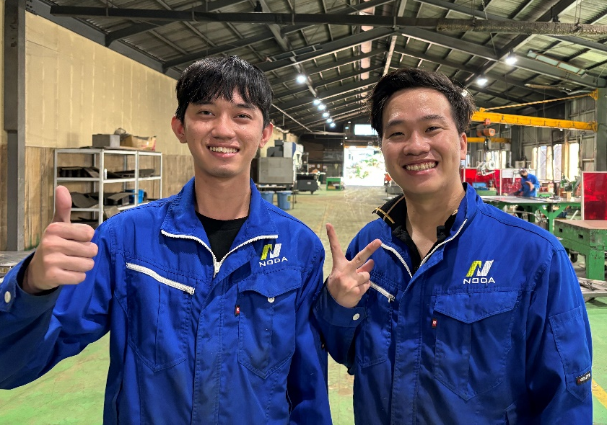
1, Introduction to Early Initiatives.
1. Transition to a new system.
A new employee has joined the company and is already making a great contribution in welding and bending.
2nd-year trainees are becoming more challenging and becoming the main force.
This season, we have started verifying individual sales and charges. Members who have acquired skills are.
I want to reflect the amount of overtime and the evaluation of salary.
NGUYEN TAN TIEN (Tien) LE TRUONG DUY (Duy)

Slide 5
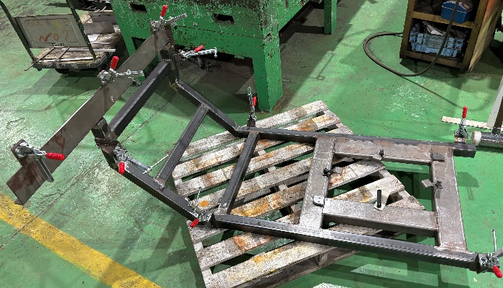
1, Early Efforts Introduction ②
1. "Verification of Products and Results"
The biggest achievement in the early stages is that all employees of the ceramics company have started inputting their own work data. With this data, it is now possible to verify the productivity of each individual as well as the validity of prices for each product.
With the enrichment of data, options such as improving production efficiency and negotiating prices have increased.
Amount negotiation.
Efficient production (utilization of jigs and tools).
1, Necessary time ○○H.
Down.
Necessary amount.
10000円
Product A
actual order amount 6000 yen -> deficit

Slide 6
This season's slogan.
Group production volume.
Top.

Slide 7
1, "This season's goals and plans."
This season's goals and plans are as follows.
Workload guarantee for pottery: Securing 72 million yen annually.
1, Target Charge 110% compared to last year.
1. All employees becoming multi-skilled (abandoning the concept of sheet metal and fabrication).
1. Manager Development (also want to develop interns)
paragraph_id: 1 Ensuring a large supply of mass-produced goods (strengthening the expertise in ceramics).
1. Data enrichment and verification for the improvement of pottery level.

