Slide 1
HO CHI MINH CITY NATIONAL UNIVERSITY
FACULTY OF NATURAL SCIENCES
DEPARTMENT OF GEOLOGY
SPECIALIZATION
ENVIRONMENTAL GEOLOGY
GRADUATION THESIS REPORT
Topic
APPLICATION OF INTEGRATED HYPERSPECTRAL REMOTE SENSING AND UAV SURVEY METHODS FOR CLASSIFICATION OF LIMESTONE - DOLOMITE ROCKS AND OPTIMIZATION OF THREE-DIMENSIONAL SPACE OBSERVATION IN GUMUNSO AREA, TAEBAEK, SOUTH KOREA
ADVISOR: TS. NGUYEN THI TO NGAN
PROF. TS. YU JAEHYUNG
STUDENT: HUYNH HUY HOA
STUDENT ID: 1616042

Slide 2
01 - INTRODUCTION
05 - CONCLUSION AND RECOMMENDATIONS
Basis for topic selection
Objectives and tasks
Steps of implementation
02 - OVERVIEW OF RESEARCH AREA
MAIN CONTENT
Natural conditions
Geological characteristics of the area
03 - RESEARCH METHODS
Data collection
Image processing method
Image classification method
UAV survey method
04 - RESULTS AND DISCUSSION
Image noise
Limestone and dolomite classification
Construction of three-dimensional space model
Integration of hyperspectral image classification and point cloud
Notes:
© Copyright Showeet.com

Slide 3
Ứng dụng và mục đích sử dụng của đá vôi – đá đolomit
Kết hợp ảnh siêu phổ và đám mây điểm trong không gian ba chiều
Ứng dụng của viễn thám trong địa chất môi trường
Sự phát triển của nền tảng UAV trong ứng dụng khoa học và kĩ thuật.
I. INTRODUCTION
I.1. Basis for topic selection

Slide 4
I. INTRODUCTION
I.2. Objectives and tasks
Mục đích
Phân loại đá vôi và đá đolomit, góp phần làm sáng tỏ đặc điểm địa chất khu vực.
Phát triển mô hình không gian ba chiều, cải thiện quan sát và lập bản đồ địa chất
Nhiệm vụ
Sử dụng phương pháp phân loại mang lại độ chính xác cao.
Xây dựng mô hình đám mây điểm, mô hình số độ cao DEM và ảnh trực giao.
Xây dựng mô hình không gian ba chiều trong phạm vi khu vực nghiên cứu

Slide 5
I. INTRODUCTION
I.3. Steps of implementation
Pp thu thập tài liệu
Tài liệu địa chất khu vực.
Tài liệu Pp rừng ngẫu nhiên và hồi quy nhị phân logistic.
Pp xử lý số liệu
Ảnh quét siêu phổ bằng Hyspex SWIR – 384.
Pp xử lý số liệu
Đăng kí hệ tọa độ và tham chiếu địa lý ảnh → ArcGIS
Hợp nhất ảnh phân loại và đám mây điểm → Autodesk 3ds Max.
Pp xử lý số liệu
Tài liệu UAV
Dữ liệu ảnh từ UAV Phantom 4 Pro+.
Phân loại ảnh siêu phổ bằng pp rừng ngẫu nhiên và hồi quy nhị phân logistic → ENVI, SPSS, R
Tạo ảnh DEM, ảnh trực giao → Agisoft PhotoScan

Slide 6
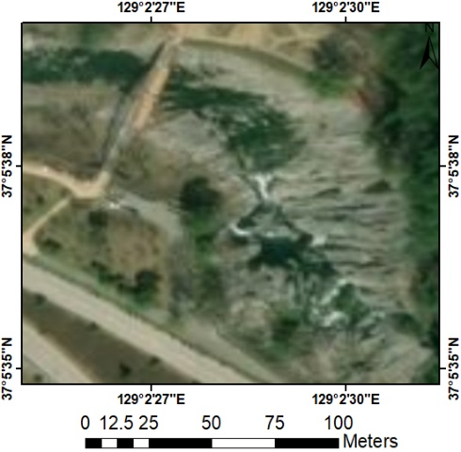
II. OVERVIEW OF RESEARCH AREA
II.1. Natural conditions
Located in the east of Seoul, characterized by rugged terrain.
The climate of Gangwon-do is characterized by high temperature and humidity in summer, and cold and dry in winter.
Figure 2.1. Map of the research area Gumunso, Taebaek, Gangwon-do, South Korea.

Slide 7
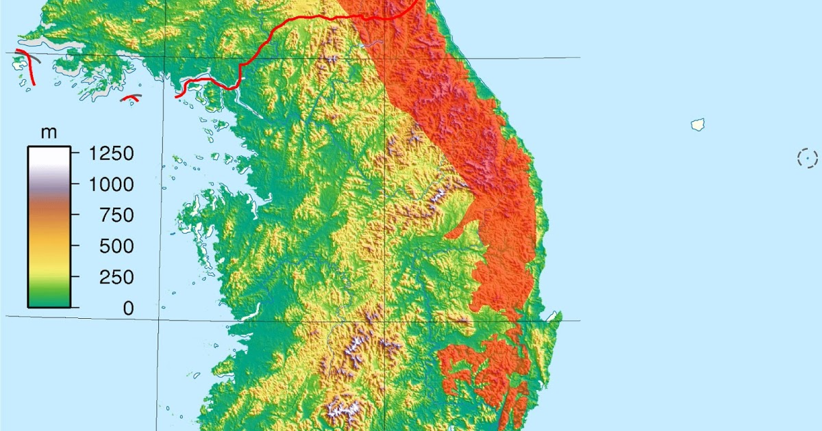
II. OVERVIEW OF THE STUDY AREA
II.1. Natural conditions
Terrain characteristics
East: steep mountain slopes with few coastal plains.
West: gentle slopes and the upper reaches of some of the largest rivers in South Korea.
The hilly area with an average elevation (from 500-1,000 meters) accounts for 43.4% in South Korea.
Figure 2.2. Topography of the study area
(the red marked area is the Taebaek mountain range)

Slide 8
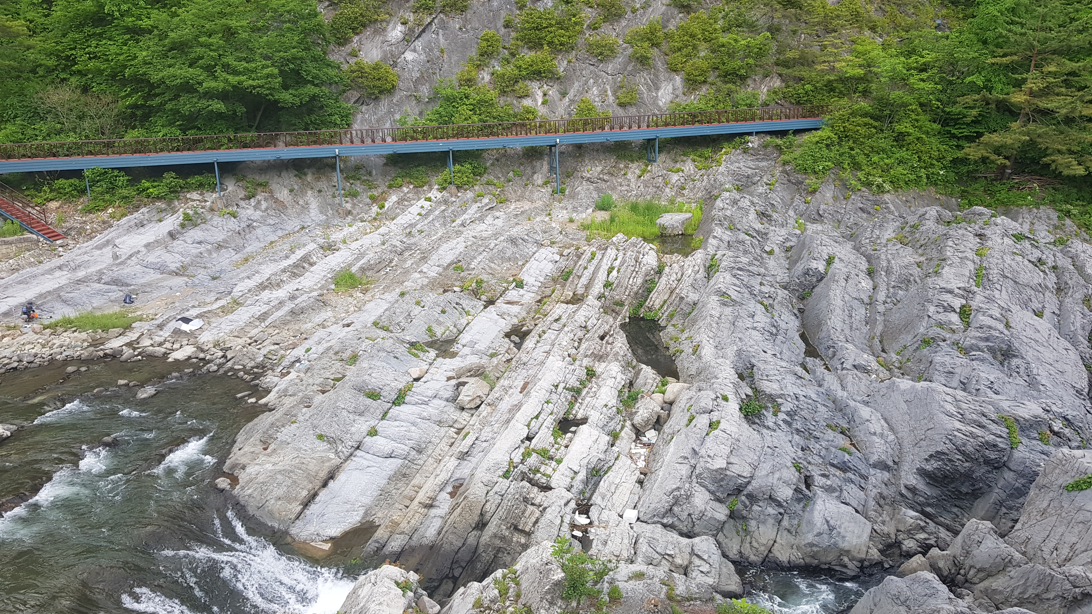
II. OVERVIEW OF THE STUDY AREA
Taebaek (hợp loạt Joseon)
Jikdong
Daegi
Hwajeol
Sangdong
Sesong
Myobong
Myeonsan
Jangsan
Jigunsan
Duwibong
Dongjeom
Makgol
Dumugol
II.2. Geological characteristics of the area
Thành phần cơ bản
Dày khoảng 45m.
Bao gồm phần lớn đá đolomit màu xám đen, đôi khi xen kẽ với kết tụ đá vôi sinh học.
Thành phần 2
Dày khoảng 80m.
Đá vôi bị quấy đục do sinh vật, đá bùn vôi, đá kết hạt lớn đến nhiều lớp, đá bùn dolomit nhiều lớp, đá dolomit lớn màu xám đen, cuội kết đá vôi và dăm kết đá đolomit
Thành phần trên cùng
Dày khoảng 60m.
Bao gồm đá tảng / cuội kết chứa xác sinh vật, đá bùn vôi stromatolitic, đá đolomit nhiều lớp và kết tụ đá granit đolomit.
Thành phần giữa
Dày khoảng 85m.
Cuội kết đá vôi bị quấy đục do sinh vật, đá bùn vôi stromatolitic, đá bùn dolomitic nhiều lớp mịn.
Makgol Formation
The Makgol Formation (250-400 m thick) is limited between limestone and dolomite rock formations and is divided into 4 components.
Figure 2.3. Field photograph of the Gumunso study area
(located within the Makgol Formation)

Slide 9
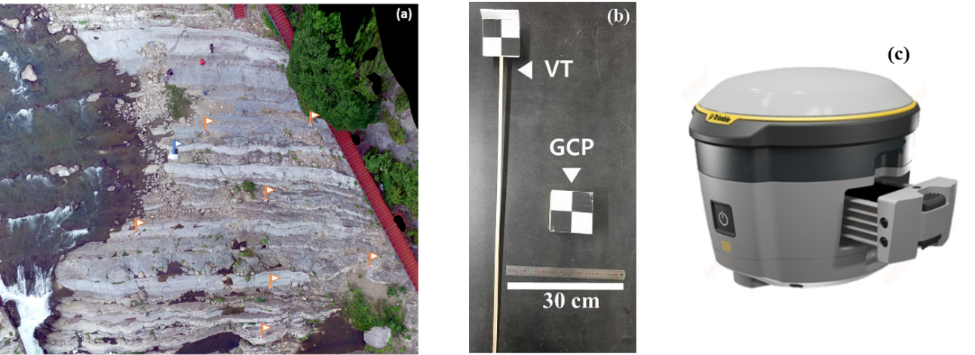
III. RESEARCH METHODS
III.1. Data collection
III.1.1. GCP design and GPS survey
7 GCPs were selected in the study area for the purpose of geometric correction and accuracy assessment of the UAV when constructing a 3D spatial model. The GCP positions were evenly distributed in the area to avoid geometric calibration errors. (Figure 3.1a, 3.1b.)
Each GCP position was averaged from at least 3 GPS measurements using the Trimble R2 GNSS satellite positioning device. (Figure 3.1c).
Figure 3.1 (a) Photograph of the GCP positions in the study area (7 control points used for geometric calibration of the point cloud and 1 GCP used for image orthorectification). (b) Photograph of the control points and GCPs used in the report. (c) Trimble R2 GNSS satellite positioning device

Slide 10
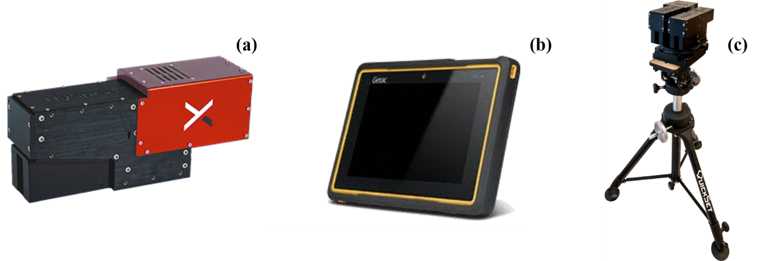
III. RESEARCH METHODS
III.1. Data collection
III.1.2. Hyperspectral imagery
Wavelength | 930 - 2500 nm
Spatial pixels | 384
Total number of spectral channels | 288
Spectral samples | 5.45 nm
FOV | 16o
Horizontal pixel FOV | 0.73 mrad
Vertical pixel FOV | 0.73 mrad
Bit resolution | 16 bit
Fastest speed | 450 fps
Power consumption | 30 W
Dimensions (length - width - height) | 38 - 12 - 17.5 cm
Weight | 5.7 kg
Figure 3.2 (a) HySpex SWIR - 384 hyperspectral camera (b) Tablet of the remote control system (c) Tripod for camera support.
Table 3.1. Specifications of the HySpex SWIR - 384 hyperspectral camera

Slide 11
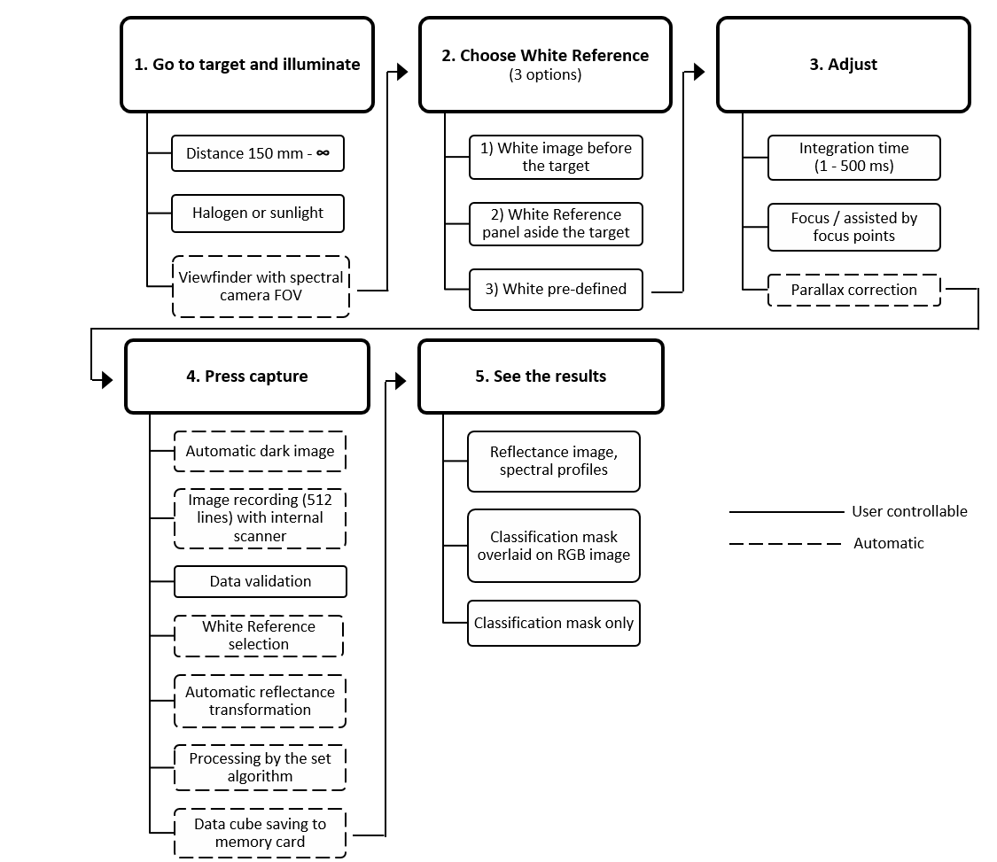
III. RESEARCH METHODS
III.1. Data collection
III.1.2. Hyperspectral imagery
Figure 3.3. Sequence of operations of the Hyspex SWIR - 380 hyperspectral camera.

Slide 12
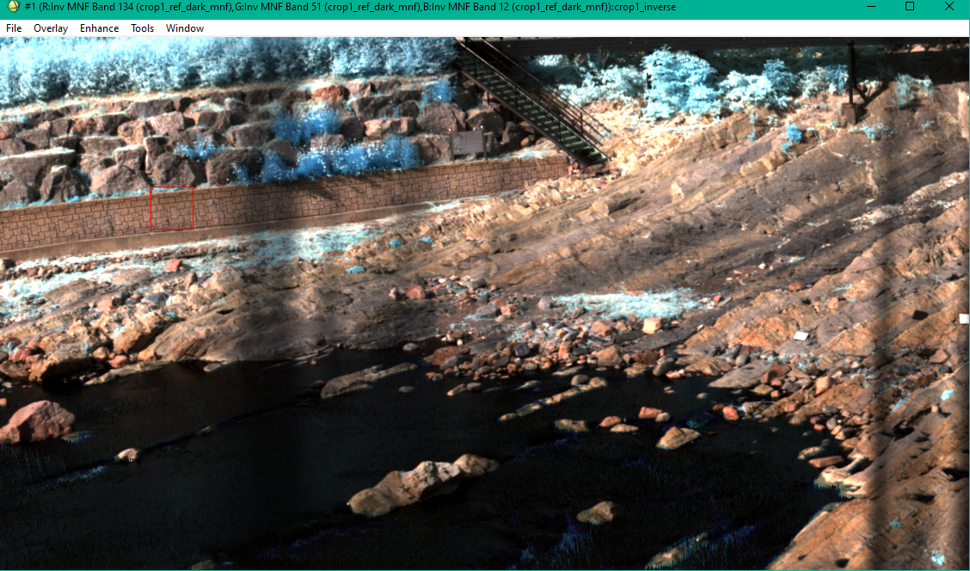
III. RESEARCH METHOD
III.1. Data collection
III.1.2. Hyperspectral images
Default spectral channel color combination:
R: 1650.5699 nm
G: 1225.8500 nm
B: 1026.2900 nm
Figure 3.4. Hyperspectral image of the study area scanned by HySpex SWIR - 384.

Slide 13
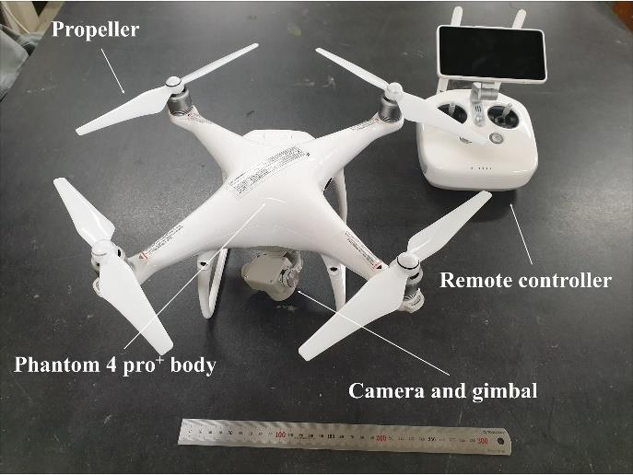
III. RESEARCH METHOD
III.1. Data collection
Weight | 1.388g (including battery and propellers)
Maximum flight time | 30 minutes
Satellite system | GPS/GLONASS
Accuracy during movement | Vertical: ± 0.5 to 1 m
 | Horizontal: ± 0.3 to 1.5 m
Accuracy of angle during movement | ±0.01o
Camera sensor | 1'' CMOS (20M effective pixels)
FOV | 84o
Lens | Focal length: 8.8mm
Resolution | 5472 x 3648 pixels
Dimensions (length - width - height) | 38 - 12 - 17.5 cm
Remote control distance | Up to 4 km
III.1.3. Point clouds
In this study, point cloud data was generated from the DJI's Phantom 4 pro+ UAV, conducted from 3:00 PM to 5:30 PM on May 28, 2020. The weather conditions were sunny with no strong winds or gusts. The UAV's flying altitude was 40m.
Figure 3.5. Structure of DJI's Phantom 4 Pro+ and its components
Table 3.2. Specifications of the Phantom 4 Pro+

Slide 14
III. RESEARCH METHOD
III.2. Image processing method
Chuyển giá trị DN sang hệ số phản xạ
Qui đổi theo thang đo quang phổ mà chúng ta có thể nghiên cứu.
Dễ dàng hơn trong việc phân loại các đối tượng dựa vào độ hấp thụ quang phổ khác nhau của chúng.
Loại bỏ hiệu ứng tán xạ khí quyển (Dark Substract)
Loại bỏ sử ảnh hưởng của tán xạ khí quyển khỏi hình ảnh.
Giảm độ nhiễu bằng Minimum Noise Fraction (MNF)
Phép biến đổi các thành phần chính và cân bằng lượng nhiễu trong mỗi kênh ảnh.
Thuật toán giữ lại thông tin kênh và loại bỏ các thành phần kênh nhiễu chủ yếu
p = (M * DN + A) / sin(θSE)
p: reflectance coefficient.
M: channel-dependent scaling factor.
A: channel-dependent offset factor.
θSE: solar elevation angle (rad)

Slide 15
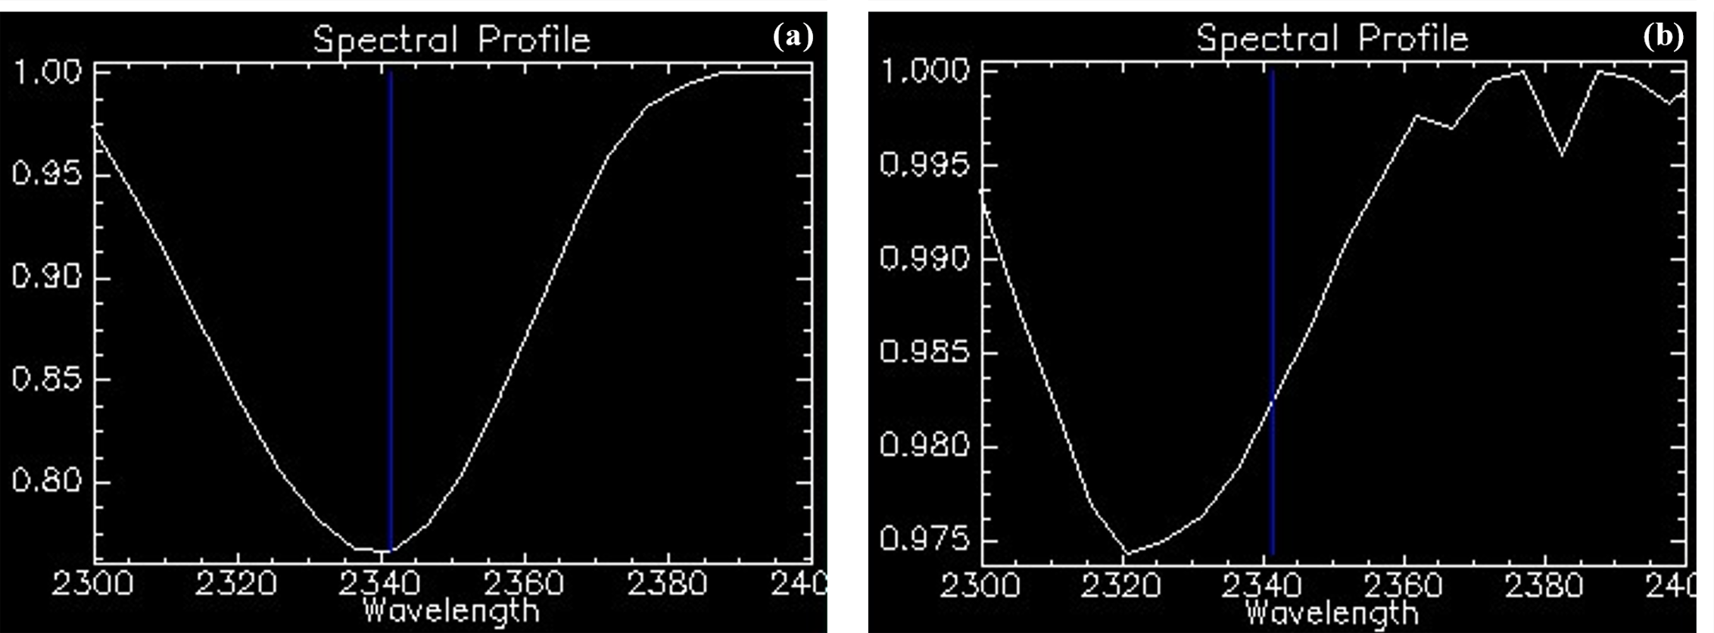
III. RESEARCH METHOD
III.3. Image classification method
III.3.1. Establishment of training data set
Figure 3.6 (a) Actual spectral absorption of limestone in the study area tested using ENVI software (b) Actual spectral absorption of dolomite in the study area tested using ENVI software.
Figure 3.5 (a) Library of spectral absorption of limestone in the range of 2340 - 2345 nm (b) Library of spectral absorption of dolomite in the range of 2320 - 2328 nm from Spectral Interpretation Field Manual AusSpec International Ltd., 2012.

Slide 16
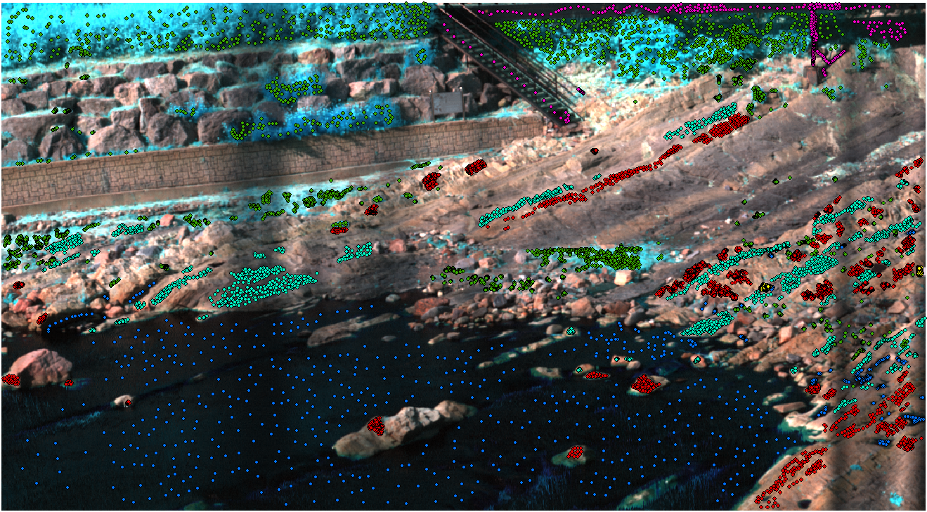
III. RESEARCH METHOD
III.3. Image classification method
III.3.1. Establishing training data
(1) Water - Blue, (2) Vegetation - Green, (3) Calibration panel - Yellow, (4) Bridge - Magenta, (5) Limestone - Cyan, (6) Dolomite - Red.
Limestone: 2800 pixels
Dolomite: 4345 pixels
Figure 3.7. Training data set used for object classification in the study area.

Slide 17
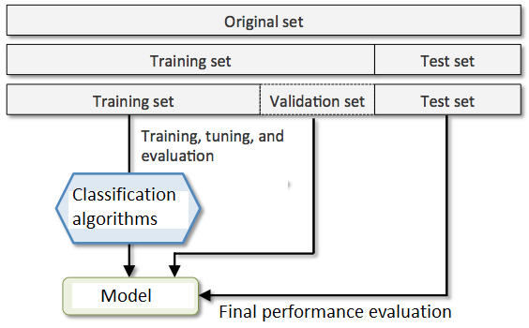
III. RESEARCH METHOD
III.3. Image classification method
III.3.1. Establishing training data
70%
30%
Is there a lot of errors in the training set?
→ "Compass" for the training set.
evaluating the effectiveness of the model, the accuracy of data classification
Figure 3.8. Algorithm used for classification and accuracy testing of the classification model in the study.
Confusion Matrix has an n x n matrix

Slide 18
III. RESEARCH METHOD
III.3. Image classification method
III.3.2. Random Forest method
Đọc, ghi, tính toán đại số, làm việc với raster dung lượng lớn
Liên kết với dữ liệu không gian, quản lý và thao tác các dữ liệu bản đồ dưới dạng vecto, raster
Đào tạo mô hình hồi quy phức tạp và các vấn đề về phân loại
raster
rgdal
caret

Slide 19
III. RESEARCH METHOD
III.3. Image classification method
III.3.2. Random Forest method
Bootstrapping
Bagging
L = (x1, x2,... xn)
Lb = (x1, x2,... xn)
1/3 of the elements not in this sample
Synthesizing results from Lb
Training the model with random samples Lb
2/3 participate in classification
1/3 test error (OOB)
Making classification predictions
Estimating important variables in classification

Slide 20
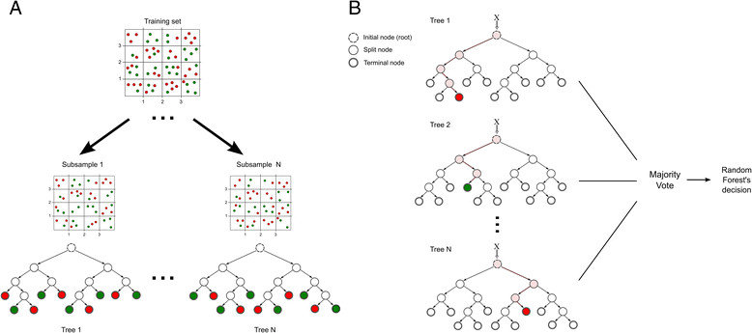
III. RESEARCH METHOD
III.3. Image classification method
III.3.2. Random Forest method
n-tree
m-try
Number of trees developed
Number of variables used for splitting at each node in the classification process
The class with the highest accuracy will participate in the overall result of the RF model
Figure 3.9. Classification process of Random Forest method.

Slide 21
III. RESEARCH METHOD
III.3. Image classification method
III.3.3. Binary Logistic Regression method
The software used in the method is Statistical Package for the Social Sciences (abbreviated as SPSS).
Supports primary data processing and analysis - which are directly collected information from the research subjects, statistical analysis of data.
Mathematically, a binary logistic model has a dependent variable with two possible values, which are represented by an indicator variable, in which the two values are labeled "0" and "1".
The binary logistic regression method is used to predict an event that only has 2 possibilities, which are limestone or dolomite, the target variable y will only have 2 values 0 or 1.
$y= \frac{e^{x}}{1+e^{x}}$ (1)
Trong đó $e^{x}=C+ x_{1}B_{1}+ x_{2}B_{2}+ … + x_{n}B_{n }$với y là xác suất xảy ra, $x_{n}$ là số kênh được dùng để phân loại, $B_{n }$là trọng số beta của kênh đó (Beta weight) và C là hằng số.

Slide 22
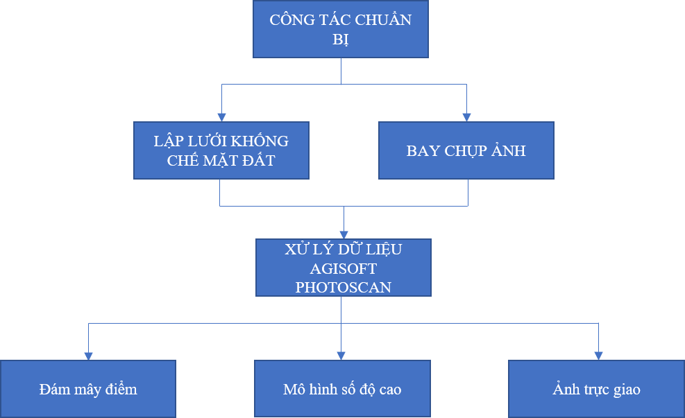
III. RESEARCH METHOD
III.4. UAV survey method
The relationship between flight altitude and image resolution is shown in the following formula:
DCB = (imW*GSD*FL) / (SSw*100)
8.8mm
40m
28.346cm
1.898cm
8448pixel
DCB: Designed flight altitude (m)
GSD: Size of the image point to be captured (cm)
imW: Width of the image in pixels
FL: Camera focal length
SSw: Width of the camera sensor
Figure 3.11. Flight and data processing workflow to create a digital model

Slide 23
III. RESEARCH METHOD
III.4. UAV survey method
The total number of UAV flights depends on the horizontal coverage of the image and can be calculated based on the following formula: FStrip = WidthPr/[M*SSh*((100 DPN%) /100)]
8
8.8mm
90m x 100m
(length x width)
18000
80%
Fstrip: Total number of flights to be calculated
WidthPr: Width of the area to be captured
M: Scale factor of the image
SSh: Height of the camera sensor
DPN: Horizontal coverage of the image (%)
Figure 3.11. Flight and data processing workflow to create a digital model

Slide 24
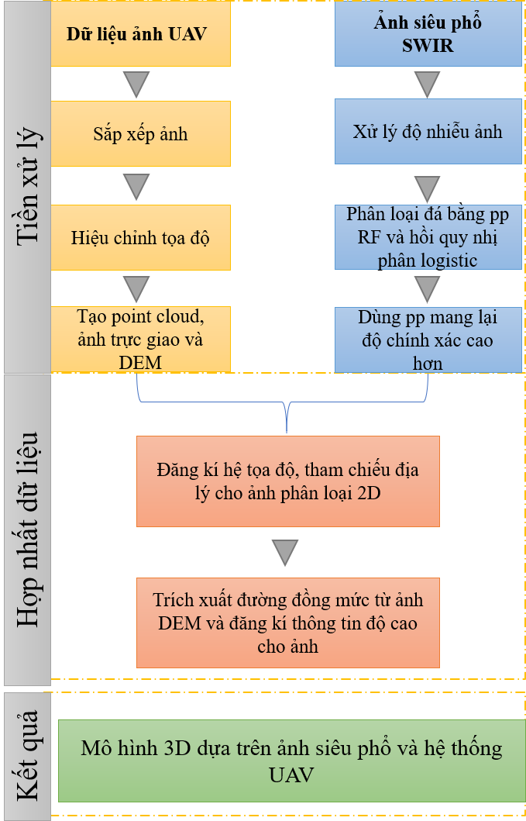
III. RESEARCH METHOD
III.5. Fusion method of hyperspectral image and point cloud
The software used in the method is Autodesk 3ds Max.
Based on the Scale-Invariant Feature Transform (SIFT) method.
Hyperspectral image
Point cloud
SIFT
SIFT
Keypoint
Keypoint
Descriptor
Descriptor
Image object recognition
Object recognition
Descriptor Comparison
Merge
Figure 3.12. Workflow for fusion of hyperspectral image and point cloud

Slide 25
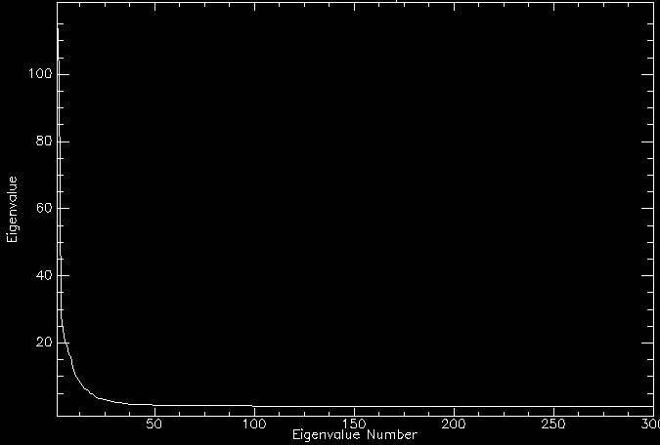
IV. IMPLEMENTATION RESULTS AND DISCUSSION
IV.1. Image Noise after Processing
IV.4.1. MNF Transformation
The chart on the side clearly shows the eigenvalue values on the vertical and horizontal axes.
Eigenvalue is the conversion coefficient in the analysis of information data, the components in the image can be used to determine the percentage of total variance explained by principal component analysis.
Select channels with eigenvalues greater than or equal to 2. Typically, the first channels will contain more information and less noise.
Tendency to decrease
The first 50 channels contain more information than the other channels
Figure 4.1. Chart of eigenvalue values in the study area

Slide 26
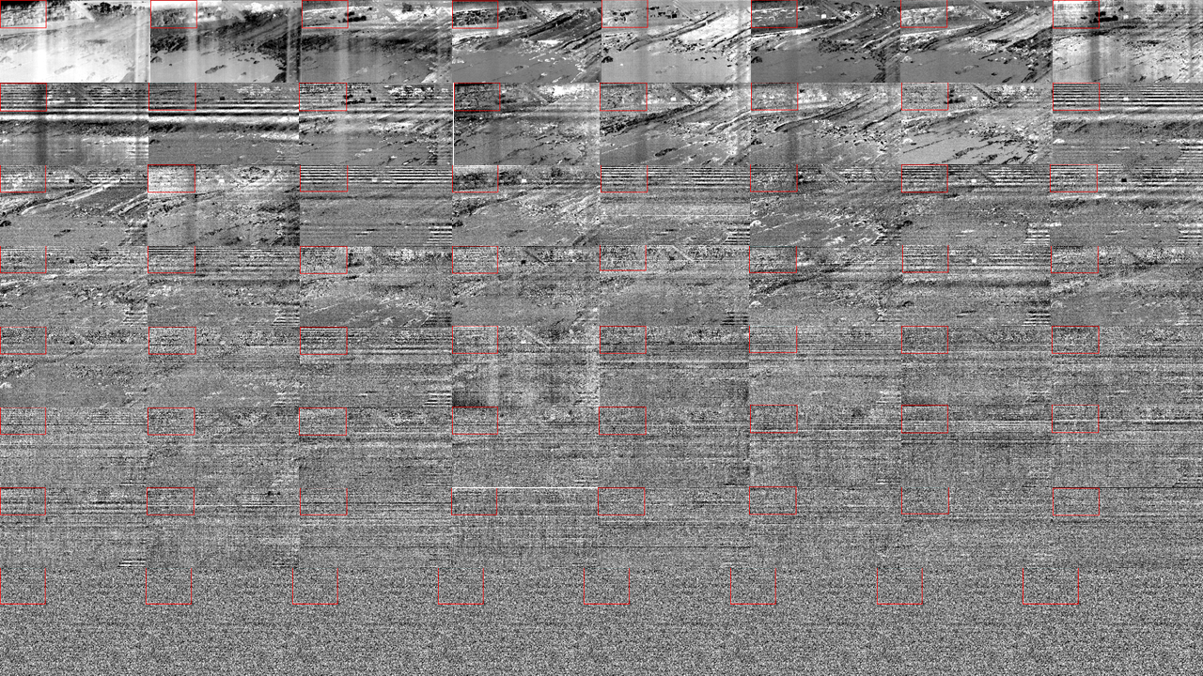
IV. IMPLEMENTATION RESULTS AND DISCUSSION
IV.1. Image Noise after Processing
IV.4.1. MNF Transformation
Table 4.1. Eigenvalue values of the first 36 channels. Among them, 34 channels with eigenvalues greater than 2 are used for inverse MNF transformation
Channel | Eigenvalue values | Channel | Eigenvalue values | Channel | Eigenvalue values
1 | 118.6557 | 13 | 8.1090 | 25 | 3.1576
2 | 99.3176 | 14 | 7.1525 | 26 | 2.9767
3 | 28.0422 | 15 | 6.4421 | 27 | 2.8539
4 | 24.0198 | 16 | 6.0360 | 28 | 2.6312
5 | 20.7301 | 17 | 5.7256 | 29 | 2.5256
6 | 19.4361 | 18 | 5.0494 | 30 | 2.4248
7 | 16.4708 | 19 | 4.7780 | 31 | 2.2771
8 | 15.9477 | 20 | 4.3953 | 32 | 2.2349
9 | 12.7086 | 21 | 3.7969 | 33 | 2.1854
10 | 10.9171 | 22 | 3.5629 | 34 | 2.0716
11 | 9.9873 | 23 | 3.3309 | 35 | 1.9849
12 | 9.0936 | 24 | 3.2855 | 36 | 1.9485
The first 50 channels contain more information than the other channels
Figure 4.2. The first channels will contain more information and less noise
34 channels with eigenvalues greater than are used for inverse MNF transformation

Slide 27
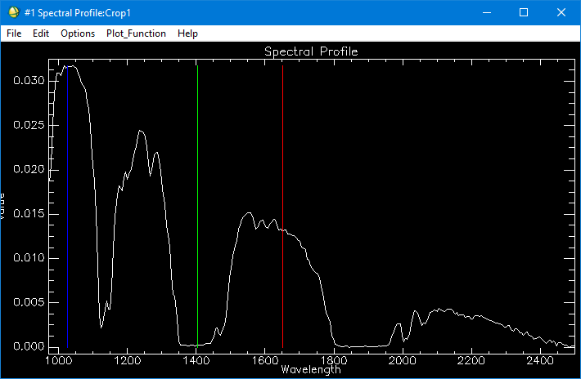
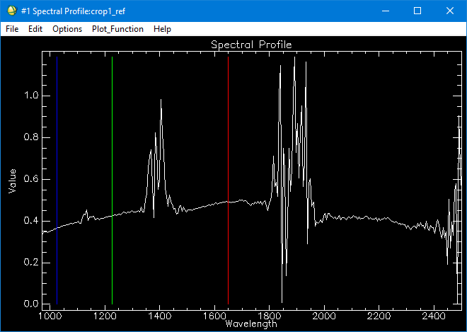
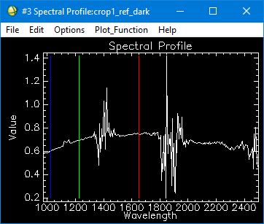
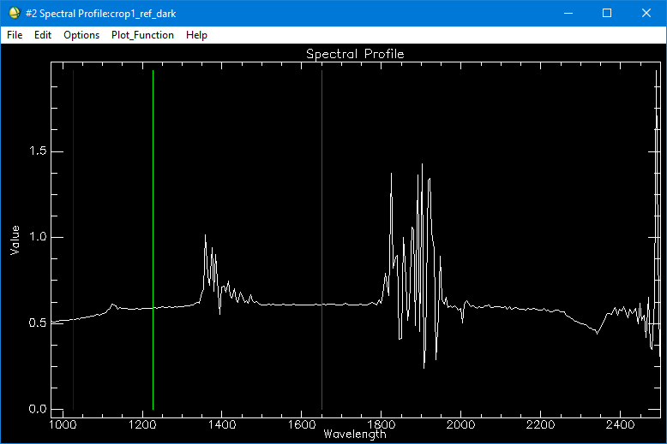
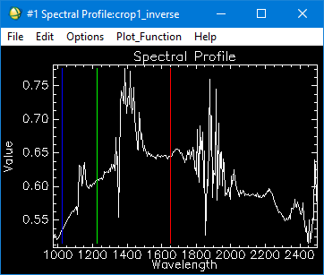
IV. IMPLEMENTATION RESULTS AND DISCUSSION
IV.1. Image Noise after Processing
Convert DN to reflectance coefficient
Dark Substract
MNF
The first 50 channels contain more information than the other channels
Figure 4.3. Summary table of image preprocessing process

Slide 28
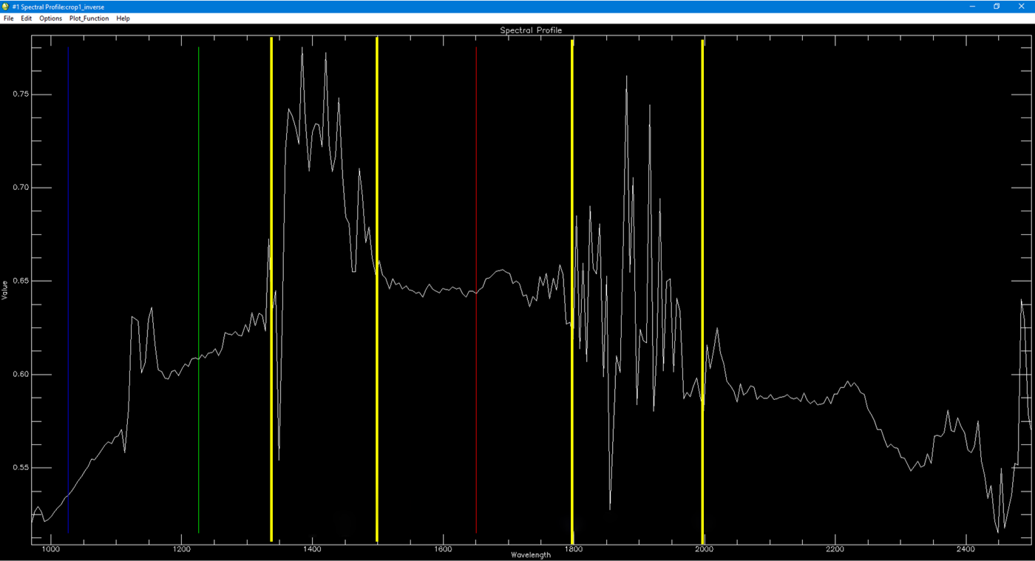
IV. IMPLEMENTATION RESULTS AND DISCUSSION
IV.1. Image Noise after Processing
Noise is concentrated from channel 73 - 102
Noise is concentrated from channel 161 - 205
The first 50 channels contain more information than the other channels
Figure 4.4. Remaining noise of the image is concentrated from channel 73 - 102 and 161 - 205

Slide 29
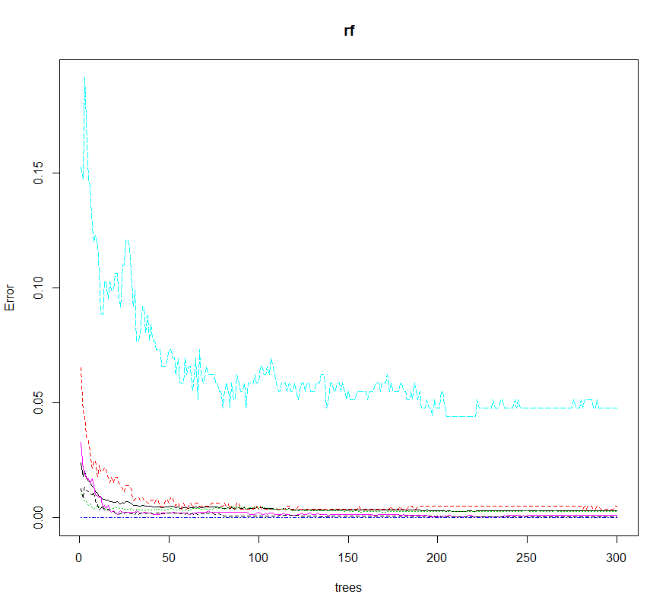
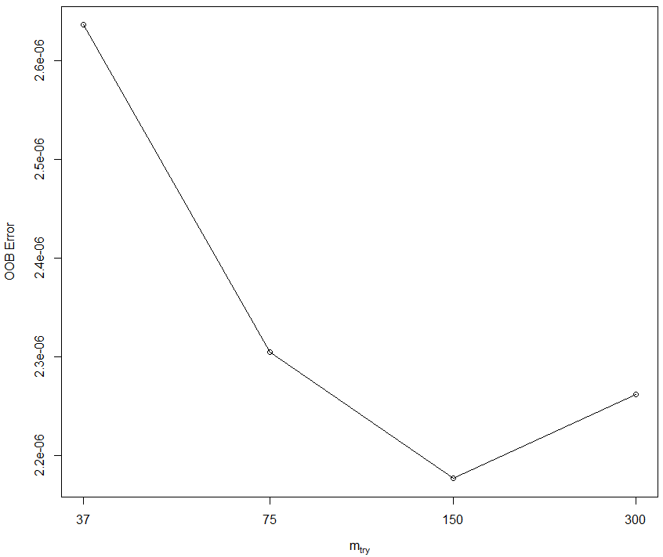
IV. IMPLEMENTATION RESULTS AND DISCUSSION
IV.2. Classification of limestone and dolomite
IV.2.1. Random Forest method
0 - 55 trees: high error rate
56 - 200 trees: lower error rate
200 trees: stable
Noise is concentrated from channel 161 - 205
The first 50 channels contain more information than the other channels
Figure 4.6 (a) OOB error rate of m-try
Figure 4.5. OOB error variation of objects

Slide 30
IV. RESULTS AND DISCUSSION
IV.2. Classification of limestone and dolomite
IV.2.1. Random forest method
Noise is concentrated from channel 161 - 205
The first 50 channels contain more information than the others
(a)
(b)
Figure 4.7 (a) Hyperspectral image of the study area (b) Object classification image of water

