Slide 1
Manual Evacuation

Slide 2
Introduction
As a soldier medic, you will be expected to extricate and remove a casualty/ies from the immediate area
It is essential that appropriate removal techniques be used to prevent additional injury

Slide 3
Overview of Manual Evacuation
Process of transporting casualties by manual carries
Accomplished without the aid of a litter or other forms of transport
Intended to end at the point where a more sophisticated means of evacuation becomes available

Slide 4
Casualty Handling
Casualties must be carefully handled
Improper handling may cause further injury
Evacuation should be organized and methodical
Moving casualties should be deliberate and gentle
Casualties should not be moved before their injuries are evaluated and treated

Slide 5
Steps Taken Prior to Moving the Casualty
Lifesaving and life-preserving measures are carried out before evacuating injured or wounded soldiers
Except in extreme emergencies, injuries must be evaluated and treated before movement is attempted

Slide 6
Steps Taken Prior to Moving the Casualty
Measures are taken, as needed, to:
Open the airway and restore breathing and heartbeat
Stop bleeding prevent or control shock
Protect the wound from further contamination
When fractures are evident or suspected, the injured part must be immobilized

Slide 7
General Rules for Bearers
Individuals performing the evacuation are referred to as bearers
Improper handling of a casualty can result in injury to the bearers and the casualty
To minimize disabling injuries (muscle strain, sprains, or other injuries) that could hamper the evacuation effort

Slide 8
Rules to Follow
Use the body's natural system of levers when lifting and moving a casualty
Know your physical capabilities and limitations
Maintain solid footing when lifting and transporting
Use the leg muscles when lifting or lowering a casualty

Slide 9
Rules to Follow
Use the shoulder and leg muscles when carrying or standing with a casualty
Keep the back straight; use arms and shoulders when pulling a casualty
Work in unison with other bearers
Rest frequently, or whenever possible

Slide 10
Manual Carries
Manual carries are tiring for bearers
Involve risk of increasing the severity of
injuries
In some instances, essential to save life

Slide 11
Manual Carries
When a litter is not available, terrain, or the tactical situation makes other forms of casualty transportation impractical
May be the only means to transport a casualty to where a combat medic can treat him

Slide 12
Manual Carry Distances
Depends on the following
Strength and endurance of the bearers
Weight of the casualty
Nature of the injuries
Obstacles encountered during transport
Terrain and weather

Slide 13
Casualty Positioning
Position the casualty to be lifted
If conscious, casualty is told how s/he will be positioned and transported
This reduces casualty's fear of movement and gains cooperation
It may be necessary to roll the casualty onto their abdomen, or back

Slide 14
One-Man Carries
Fireman's Carry
Arms Carry
Supporting Carry
Saddleback Carry
Pack-strap Carry
Pistol-belt Carry
Pistol-belt Drag
Neck Drag
Cradle-drop Drag
LBE Carries

Slide 15
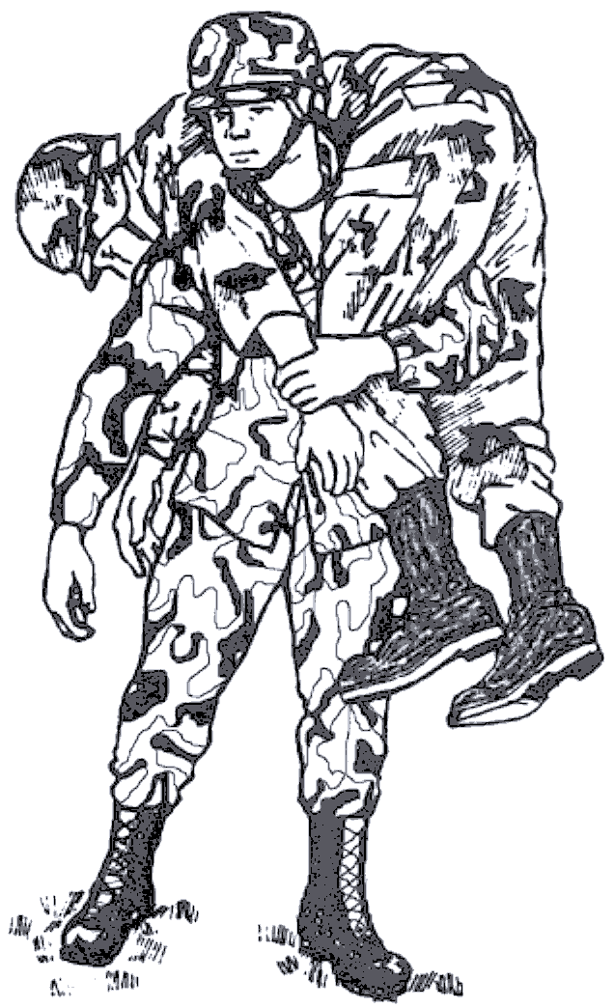
Fireman's Carry

Slide 16
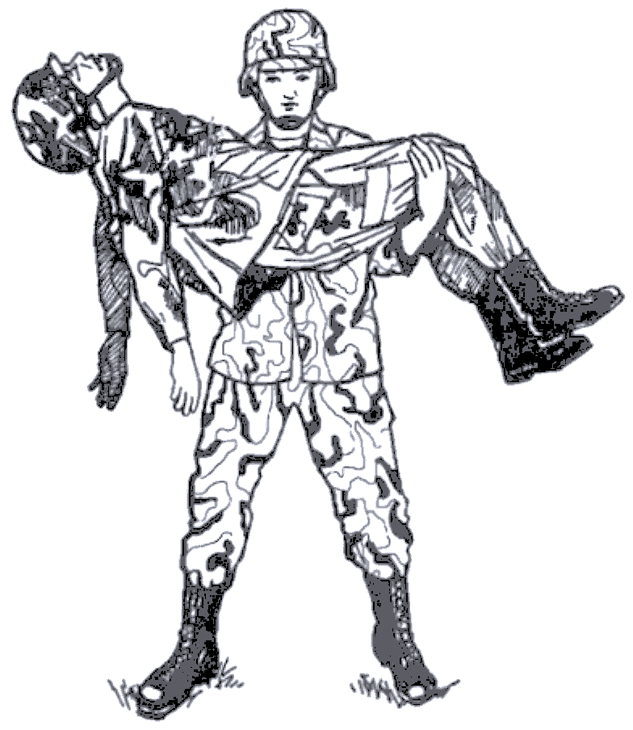
Arms Carry

Slide 17
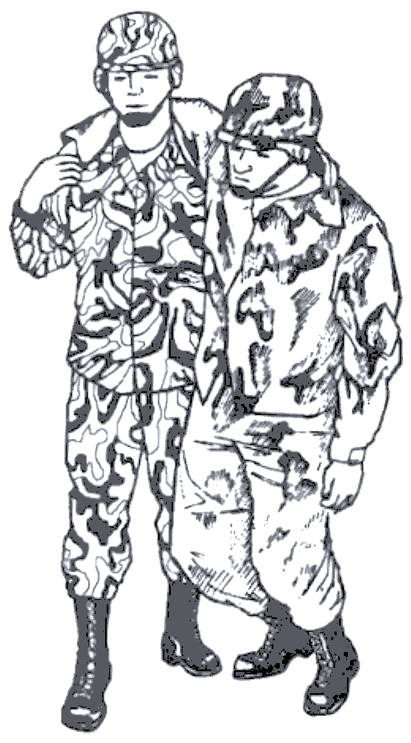
Supporting Carry

Slide 18
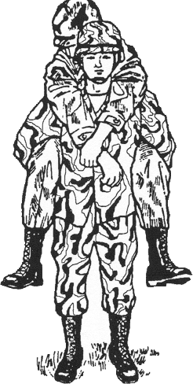
Saddleback Carry

Slide 19
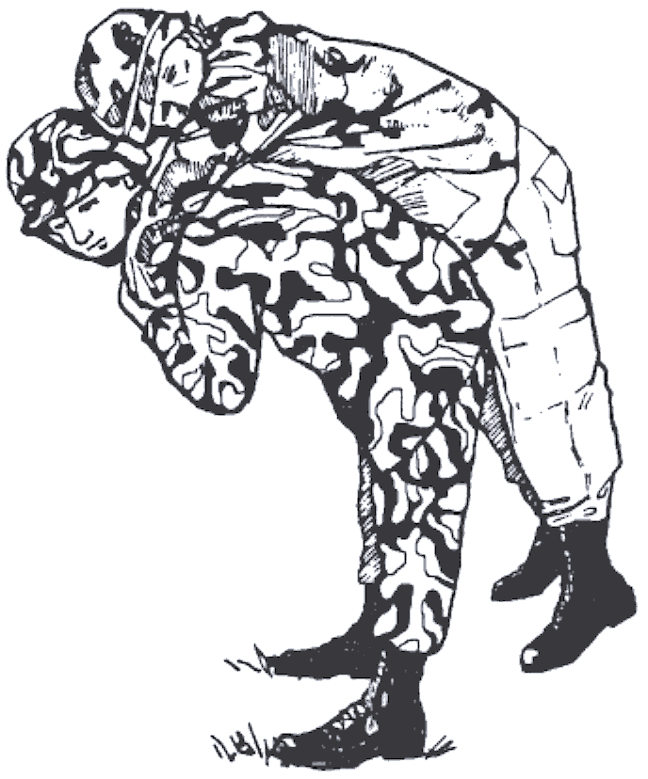
Pack-strap Carry

Slide 20
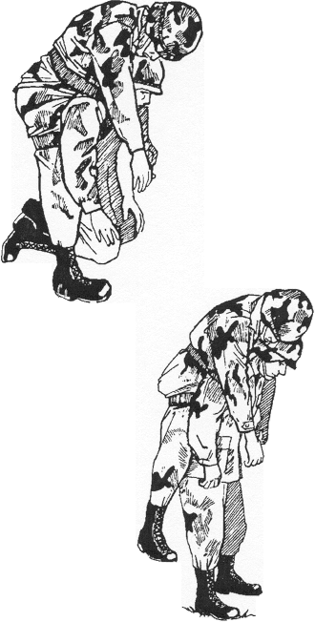
Pistol-belt Carry

Slide 21
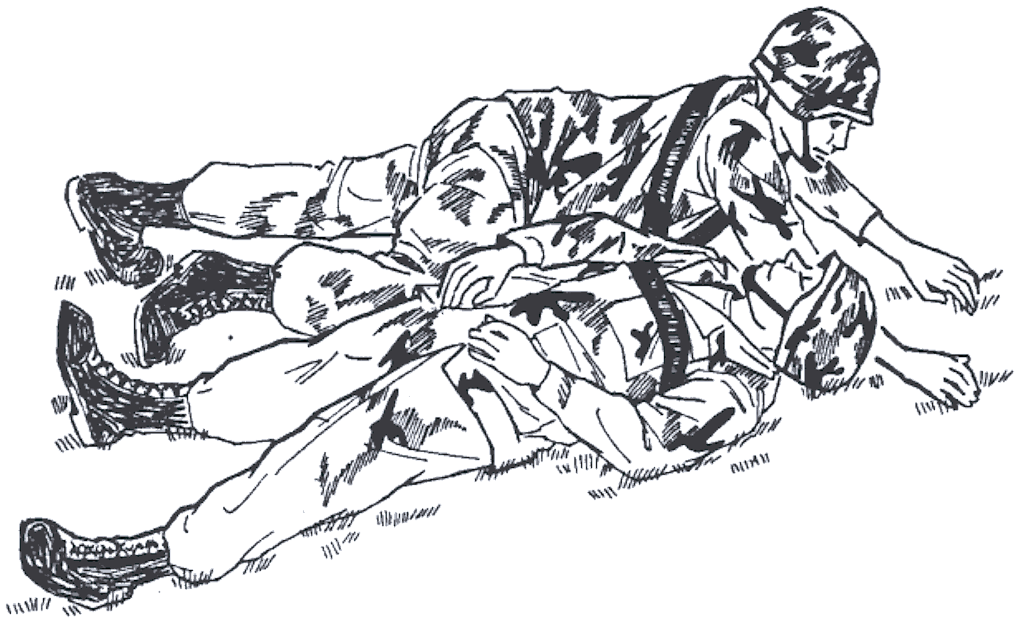
Pistol-belt Drag

Slide 22
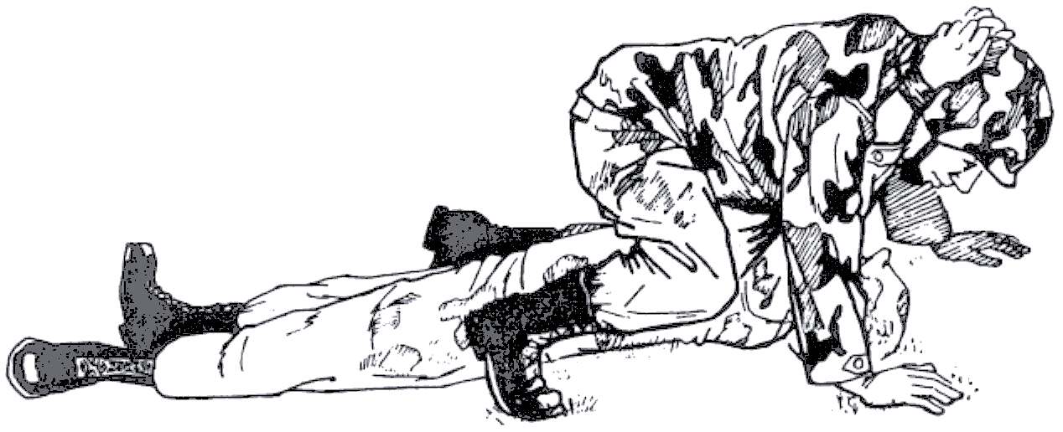
Neck Drag

Slide 23
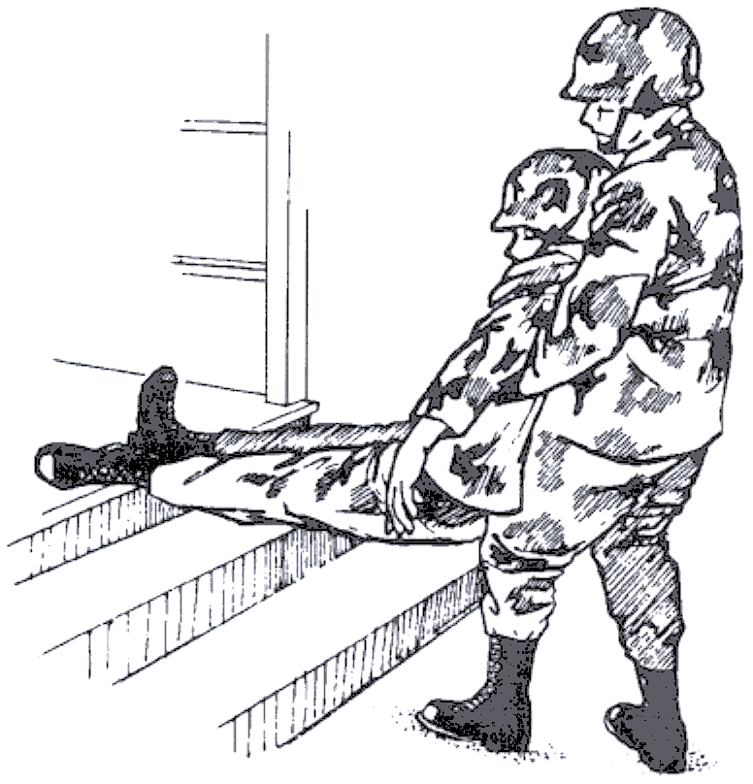
Cradle-drop Drag

Slide 24
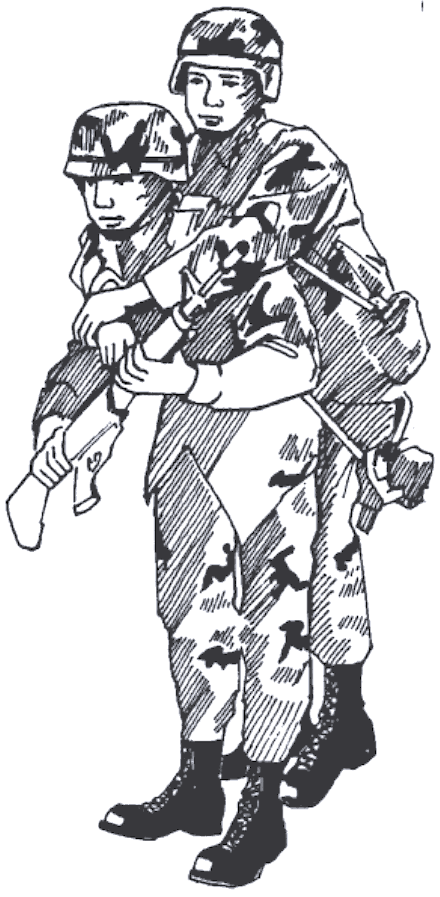
LBE Carry (Conscious Casualty)

Slide 25
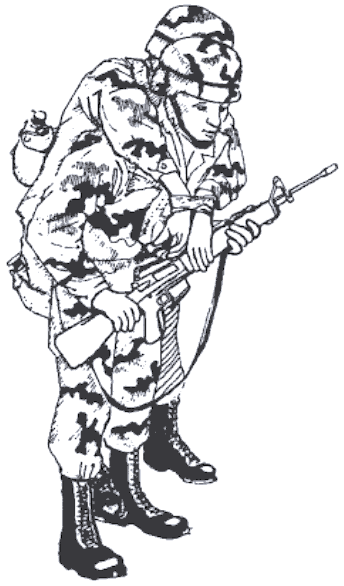
LBE Carry (Unconscious Casualty)

Slide 26
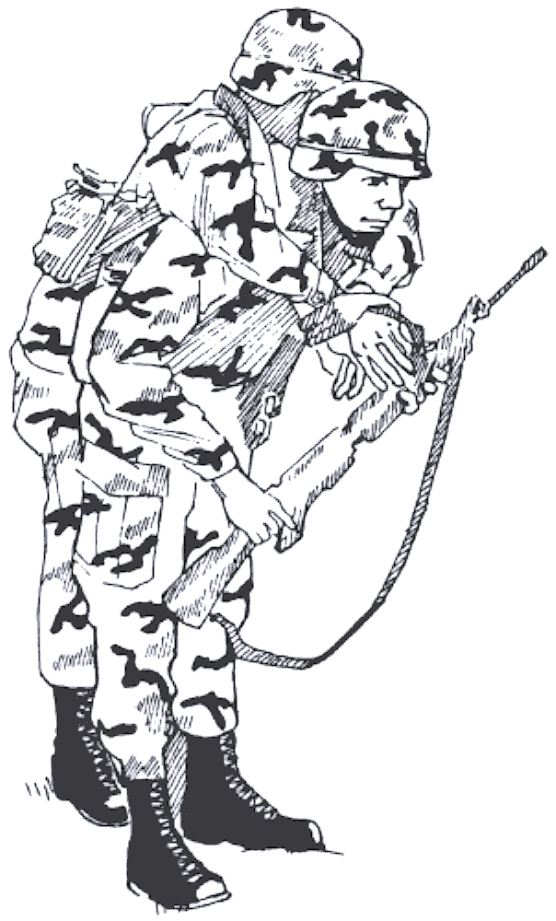
LBE Carry (Using Casualty’s LBE)

Slide 27
Two-Man Carries
Two-man supporting carry
Two-man arm's carry
Two-man fore-and-aft carry
Four hand seat carry
Two-hand seat carry

Slide 28
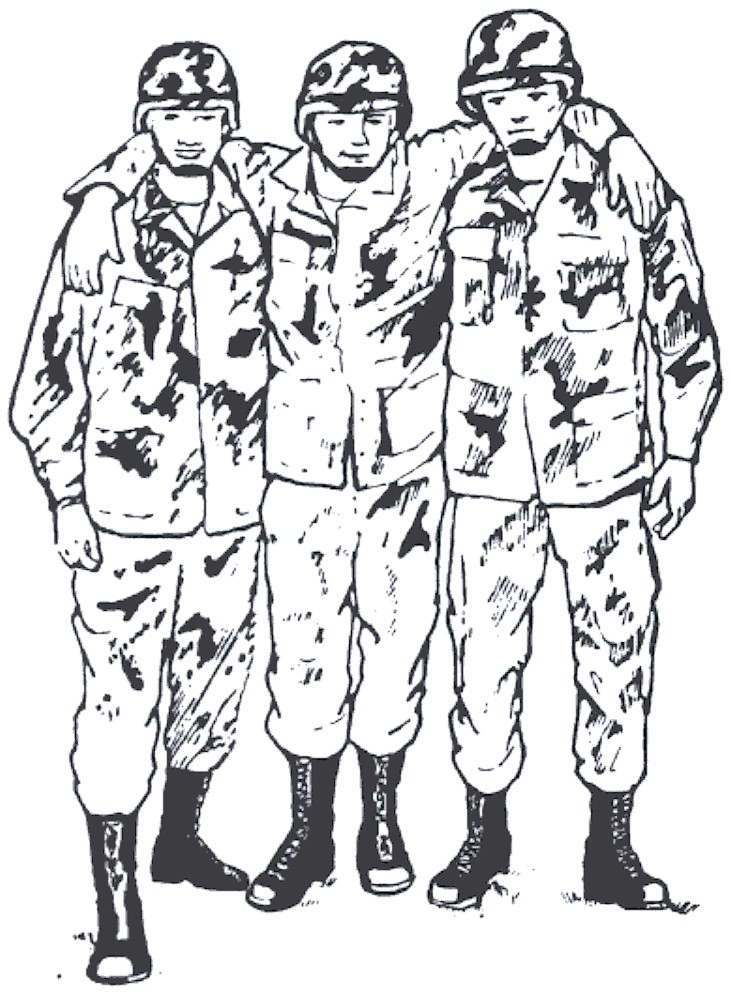
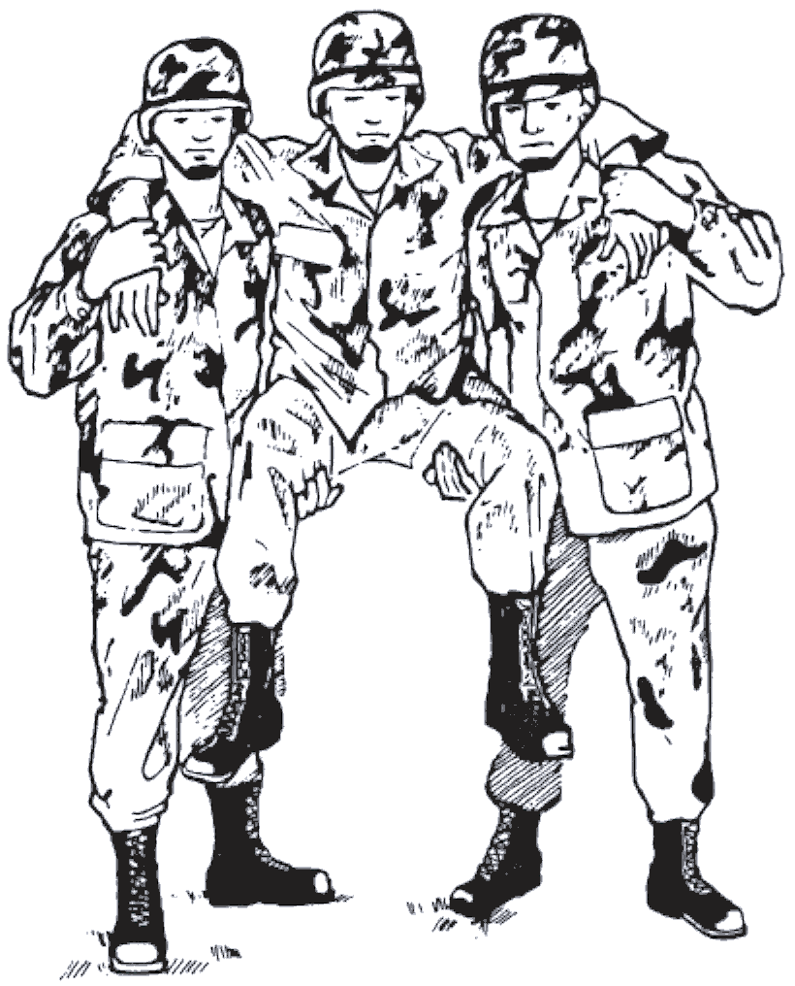
Two-man Supporting Carry

Slide 29
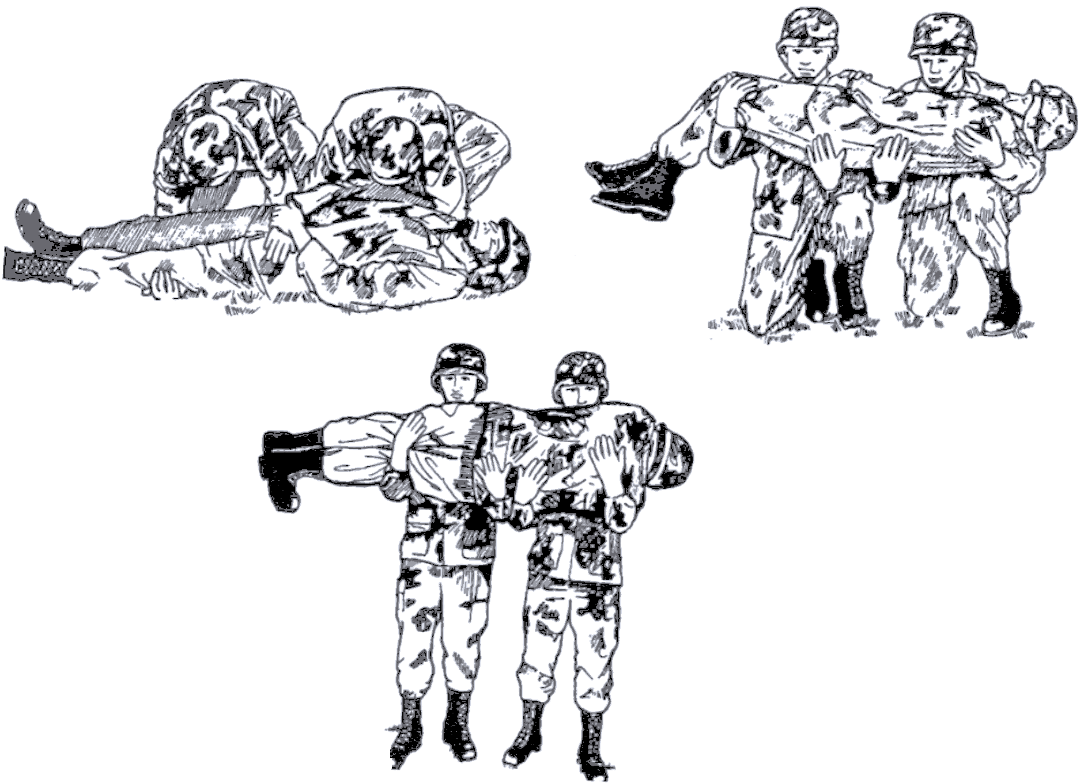
Two-man Arms Carry

Slide 30
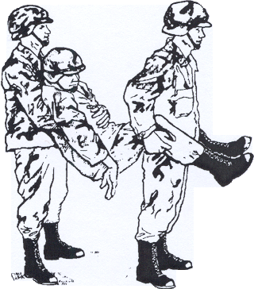
Two-man Fore and Aft Carry

Slide 31
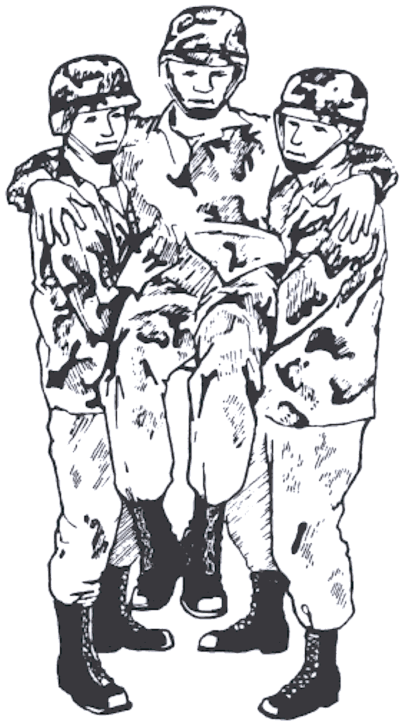
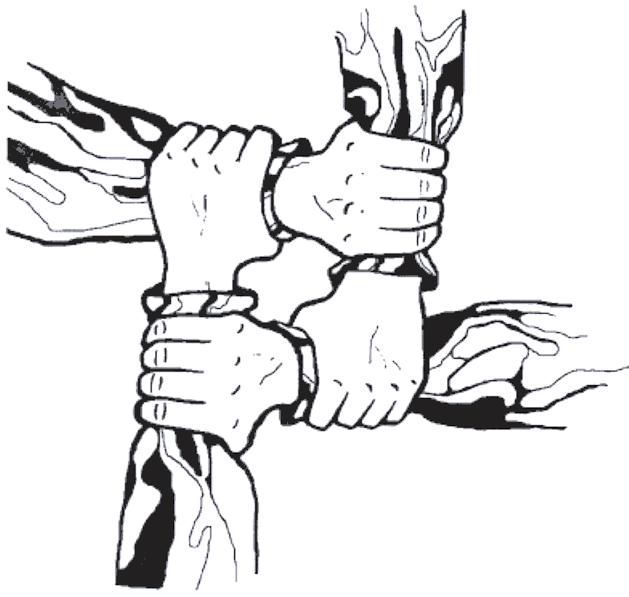
Four-hand Seat Carry

Slide 32
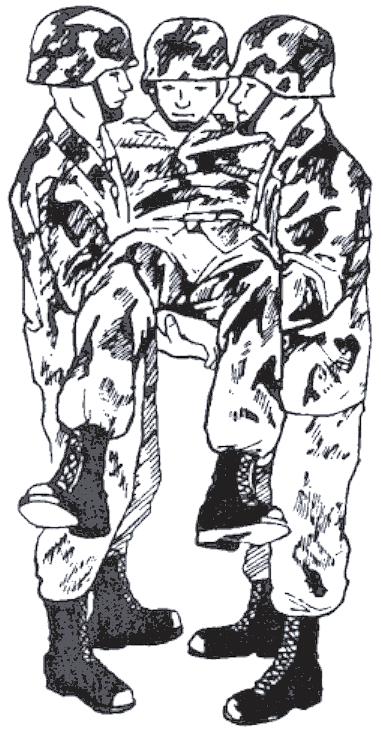
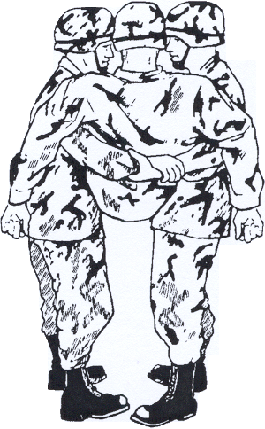
Two-hand Seat Carry

Slide 33
Special Manual Evacuation Techniques
Special techniques are required to remove injured soldiers from tanks, other armored vehicles, motor vehicles, or from other limited-access positions

Slide 34
Caution
Parking next to a battle damaged tank can draw antitank fire to the ambulance
Approach from the opposite side of the vehicle, using all available cover and concealment
Ambulance teams should park the vehicle behind protective terrain and dismount with the necessary equipment

Slide 35
Observing the Vehicle for Fire
Use fire suppression equipment and any protective measures available
Attempting to save the crew of a burning vehicle may only result in the injury or death of the rescuer
Rescuer's decision based on the specific circumstances

Slide 36
Extracting a Casualty Includes
Gaining access to the casualty
Administering lifesaving measures
Freeing the casualty from the vehicle or other limited-access positions
Preparing the casualty for removal
Transporting the casualty from the site

Slide 37
Extricating Casualty’s From a Tank
Removing a wounded soldier from the interior of a tank is difficult and requires speed
Crew members should be used to extract casualties from tanks
Removing casualties from a tank requires 3 crew members/soldiers

Slide 38
Steps Medical Personnel Should Take
If a head and or spine injury are suspected stabilize the neck as much as possible prior to attempting to extract the casualty
Depending upon the tactical situation, these procedures may be abbreviated if the vehicle and its crew are in imminent danger

Slide 39
Summary
Battlefield, extrication a challenging task
We have identified steps, procedures, and rules of manual evacuation
As a soldier medic, you must have an understanding of manual evacuation to prevent injury to yourself and further injury to soldiers in your care

