Slide 1
ＮＯＤＡ
NODA Group Management Guidelines Presentation

Slide 2
代表取締役 野田 裕紀
Ceramic Technology Research

Slide 3
Preliminary results.
Sales: 57.83 million (87%) (last year 50.80 million)
Achievement rate of 96% (86% last year).
Unable to reach the goal, workload.
Ensuring was the biggest challenge.
Sales have been sluggish since May.
Charge has also worsened.
In January, in terms of attendance and work.
There were issues and I provided guidance.

Slide 4
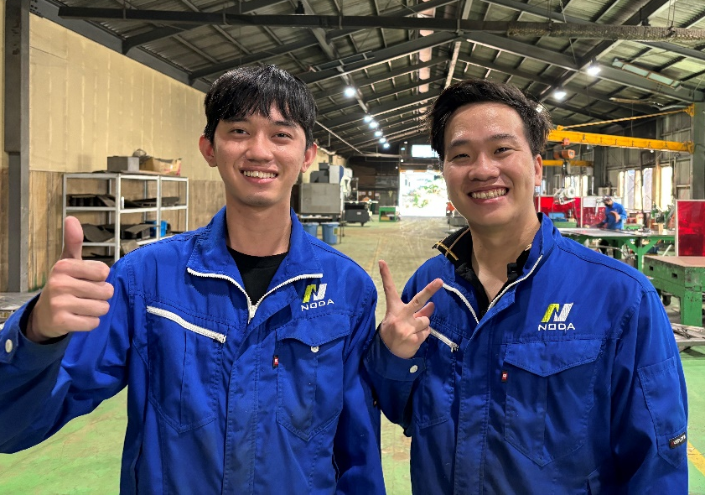
Introduction to Early Initiatives ①
Transition to a new system ✨
A new employee has joined the company and is already making a great contribution in welding and bending.
Second-year and subsequent trainees are becoming more challenging and taking on more difficult tasks, becoming the main force.
This season, we have started verifying individual sales and charges. Members who have acquired skills are.
I want to reflect the amount of overtime and the evaluation of salary.
NGUYEN TAN TIEN (Tien) LE TRUONG DUY (Duy)

Slide 5
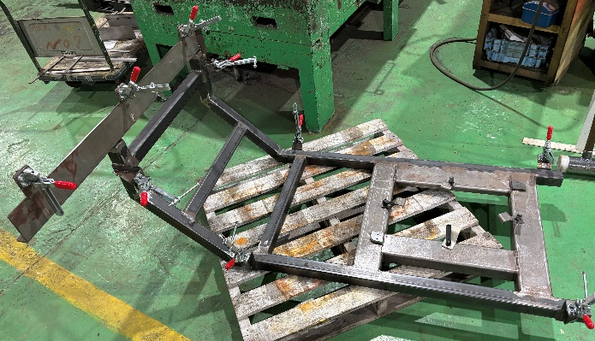
Introduction to Early Stage Initiatives ②
Product and outcome verification.
The biggest achievement in the early stage is that all employees of the ceramics company have started inputting their own work data. With this data, it is now possible to verify the productivity of each individual as well as the validity of prices for each product.
With the enrichment of data, options such as improving production efficiency and negotiating prices have increased.
Negotiation of amount.
Efficient production (utilization of jigs and tools)
Necessary time ○○H.
Down.
Necessary amount.
10000円
Product A
Actual order amount 6000 yen → Deficit.

Slide 6
This season's slogan.
Production volume within the group.
Top.

Slide 7
This season's goals and plans.
The goals and plans for this term are as follows.
Ensuring Sufficient Work Volume for Pottery: Securing 72 million yen annually.
Target charge 110% compared to last year.
All employees become multi-skilled (abandoning the concept of sheet metal and fabrication).
Manager development (also want to develop interns)
Ensuring a large supply of mass-produced goods (strengthening the expertise in ceramics).
Improvement of pottery through data enrichment and verification.

